Slide 1
Autoencoders
What they do, how they work and why they are cool…
(lots of code at http://adl.toelt.ai/)

Slide 2
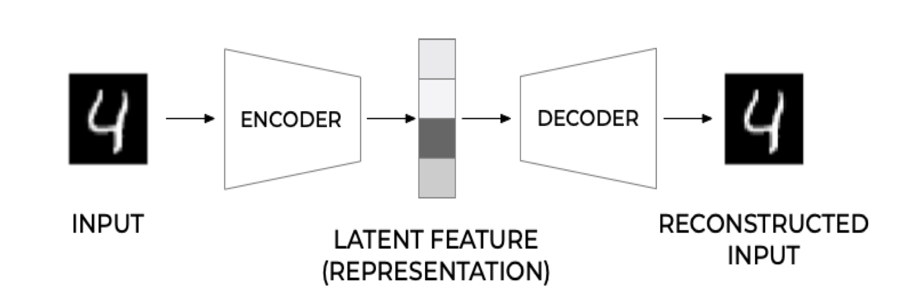
General Structure
Michelucci, Umberto. "An Introduction to Autoencoders." arXiv preprint arXiv:2201.03898 (2022).

Slide 3
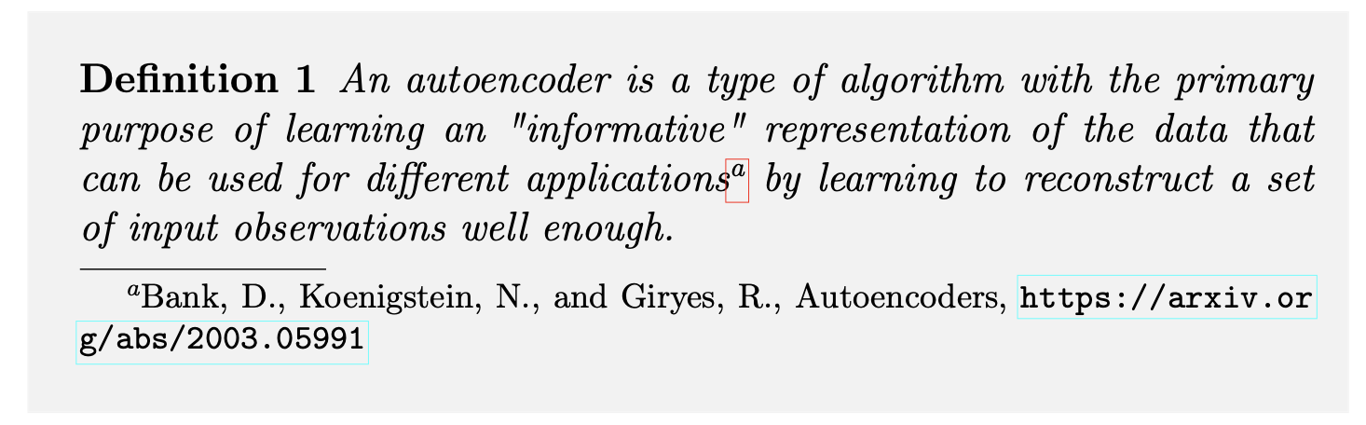
Definition
Michelucci, Umberto. "An Introduction to Autoencoders." arXiv preprint arXiv:2201.03898 (2022).

Slide 4
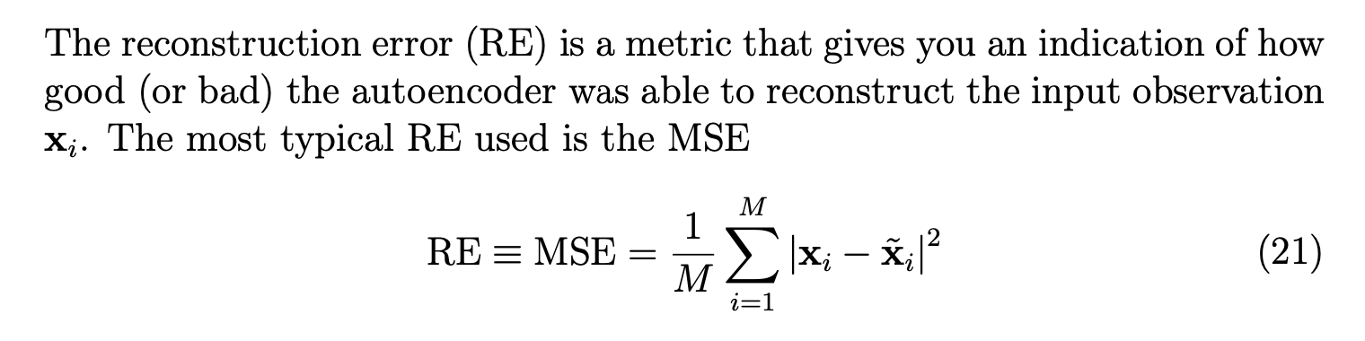
Reconstruction Error
Michelucci, Umberto. "An Introduction to Autoencoders." arXiv preprint arXiv:2201.03898 (2022).

Slide 5
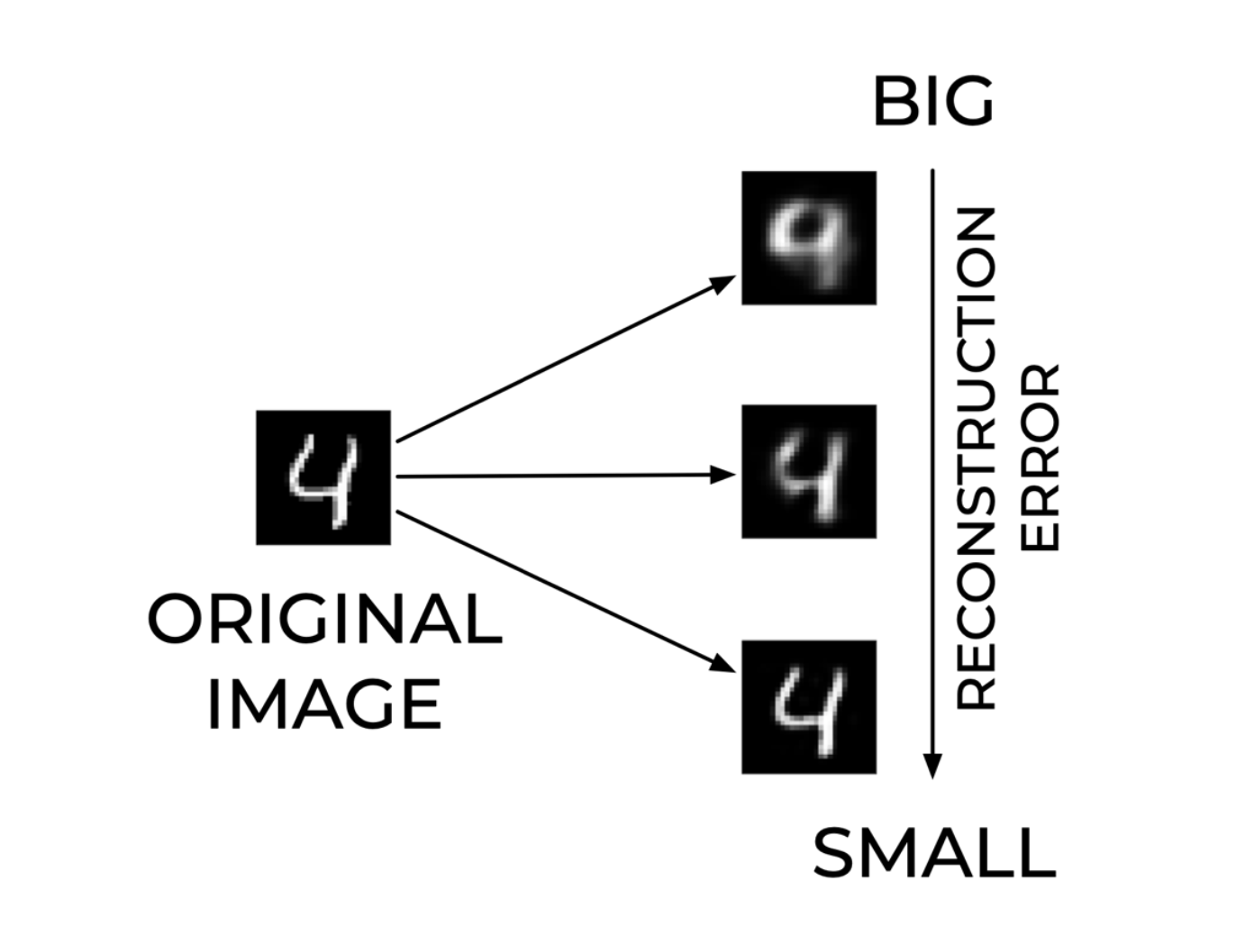
Reconstruction Error – An Example
Michelucci, Umberto. "An Introduction to Autoencoders." arXiv preprint arXiv:2201.03898 (2022).

Slide 6
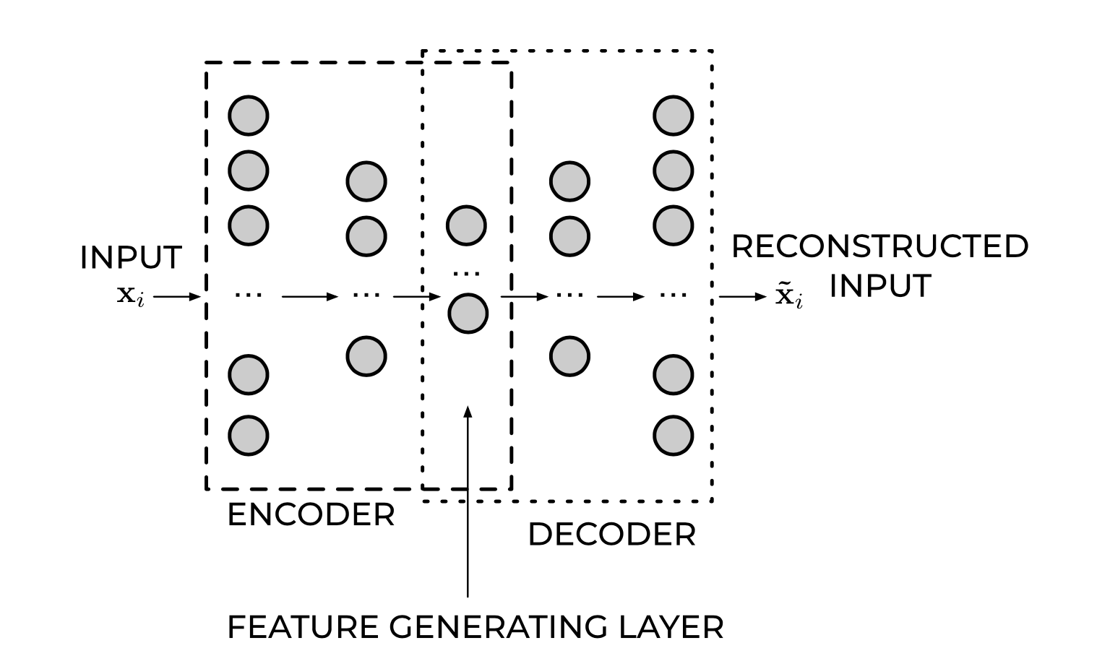
Feed Forward Autoencoders
Michelucci, Umberto. "An Introduction to Autoencoders." arXiv preprint arXiv:2201.03898 (2022).

Slide 7
Smaller autoencoders and results

Slide 8
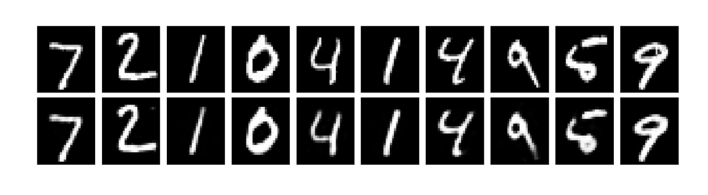
Examples (784,64,784)
Michelucci, Umberto. "An Introduction to Autoencoders." arXiv preprint arXiv:2201.03898 (2022).

Slide 9
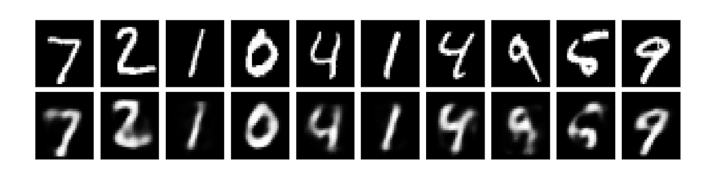
Examples (784,16,784)
Michelucci, Umberto. "An Introduction to Autoencoders." arXiv preprint arXiv:2201.03898 (2022).

Slide 10
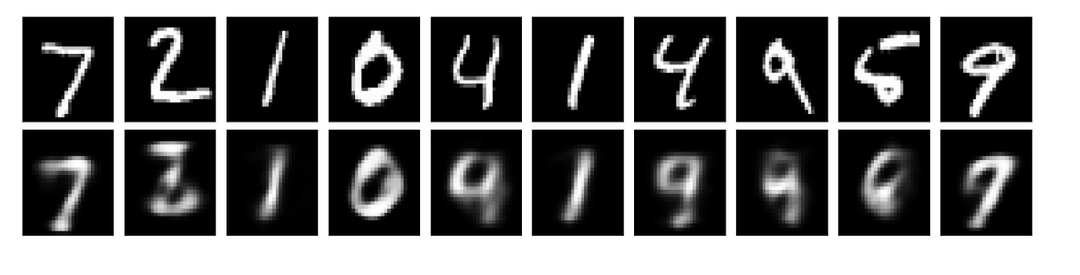
Examples (784,8,784)
Michelucci, Umberto. "An Introduction to Autoencoders." arXiv preprint arXiv:2201.03898 (2022).

Slide 11
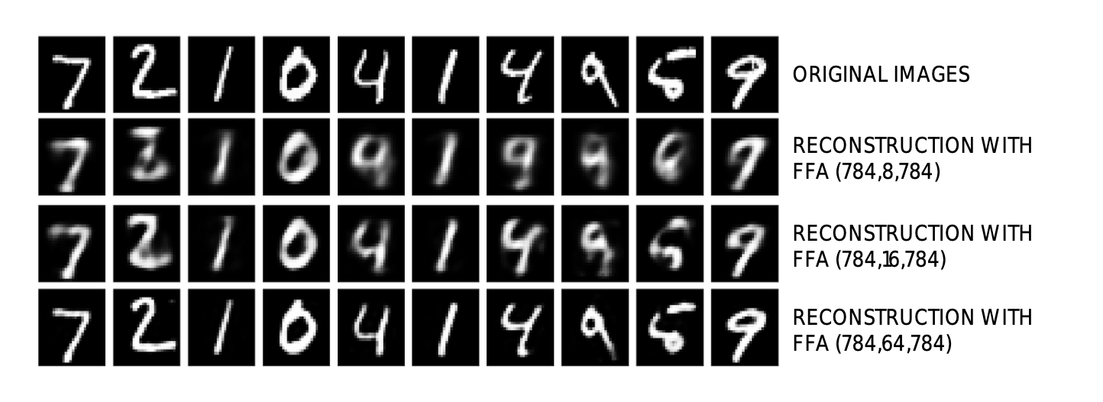
Examples (784,8,784)
Michelucci, Umberto. "An Introduction to Autoencoders." arXiv preprint arXiv:2201.03898 (2022).

Slide 12
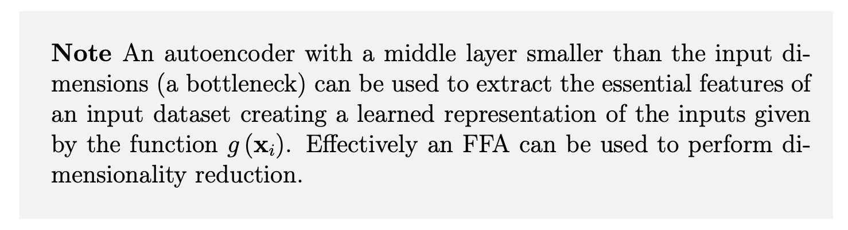
Dimensionality Reduction
Michelucci, Umberto. "An Introduction to Autoencoders." arXiv preprint arXiv:2201.03898 (2022).

Slide 13
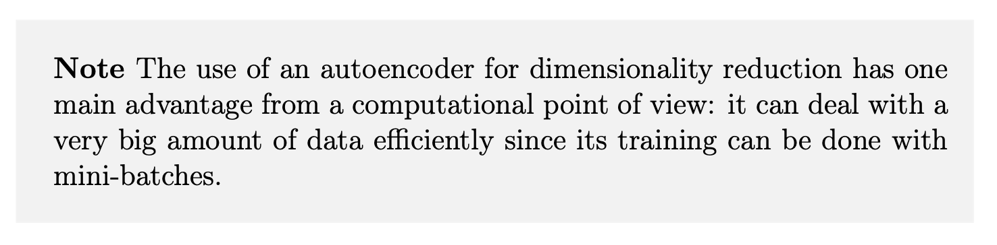
Dimensionality Reduction - Advantages
Michelucci, Umberto. "An Introduction to Autoencoders." arXiv preprint arXiv:2201.03898 (2022).

Slide 14
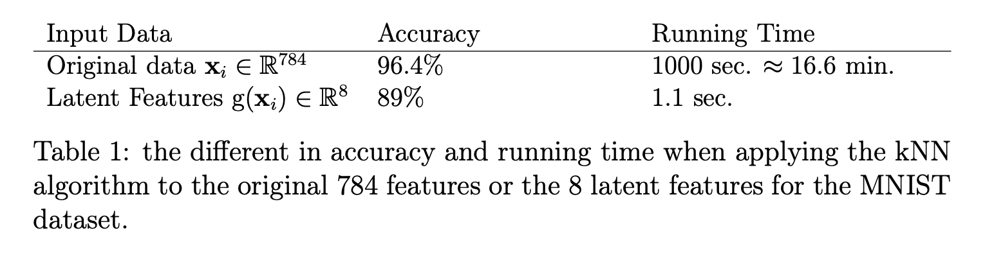
Latent Features for classification (kNN with k=7)
Michelucci, Umberto. "An Introduction to Autoencoders." arXiv preprint arXiv:2201.03898 (2022).

Slide 15
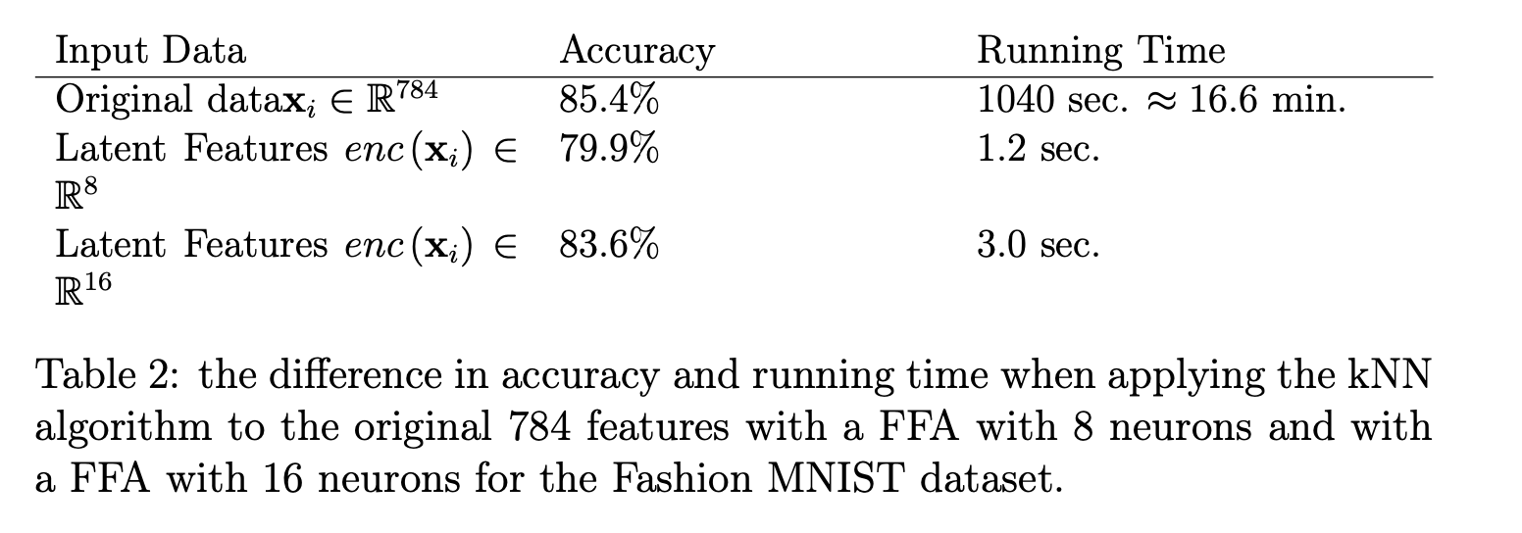
Latent Features for classification (kNN with k=7)
Michelucci, Umberto. "An Introduction to Autoencoders." arXiv preprint arXiv:2201.03898 (2022).

Slide 16
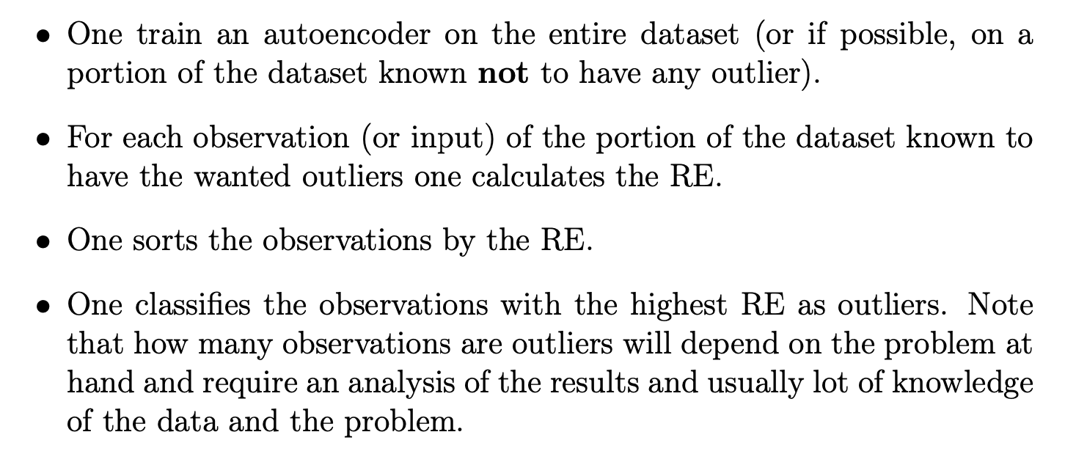
Anomaly Detection - Steps
Michelucci, Umberto. "An Introduction to Autoencoders." arXiv preprint arXiv:2201.03898 (2022).

Slide 17
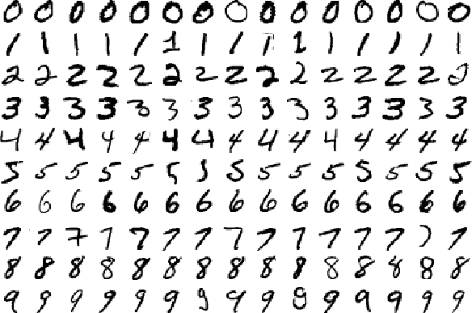
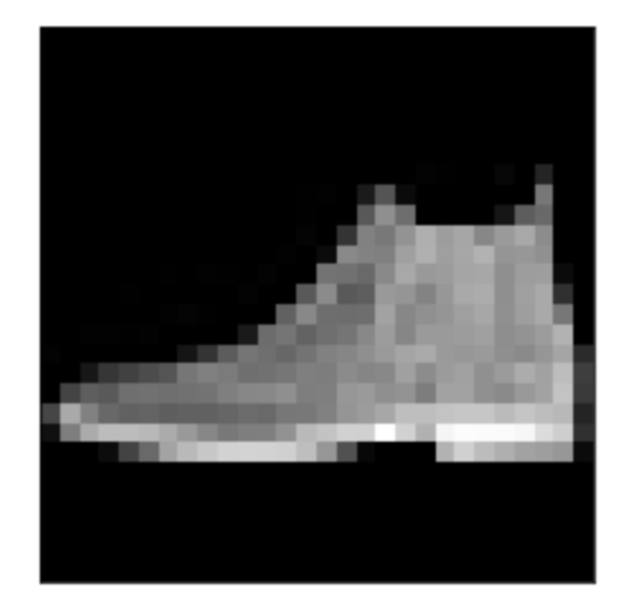
Anomaly Detection
The Dataset
The anomaly

Slide 18
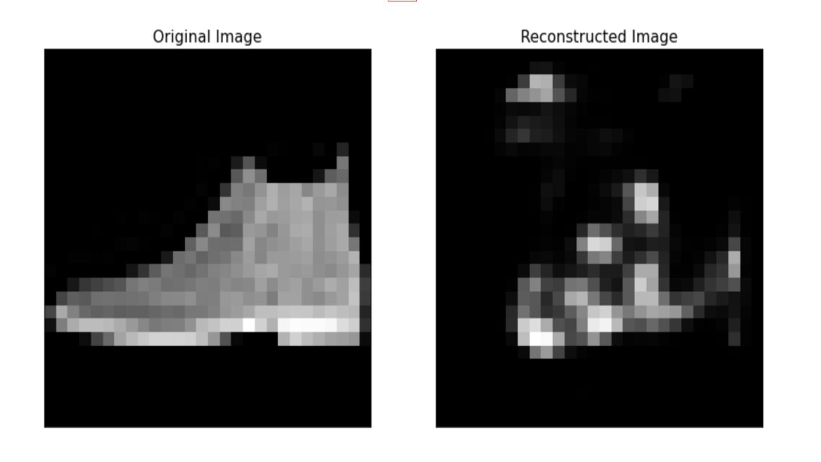
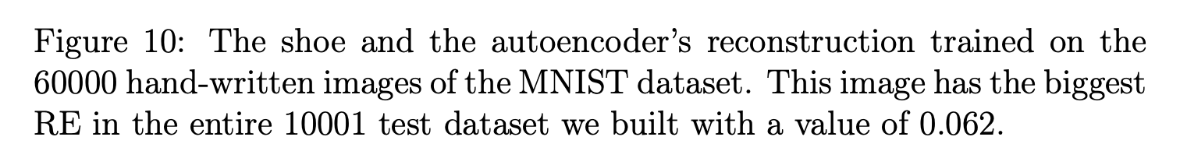
Anomaly Detection – A shoe…
Michelucci, Umberto. "An Introduction to Autoencoders." arXiv preprint arXiv:2201.03898 (2022).

Slide 19
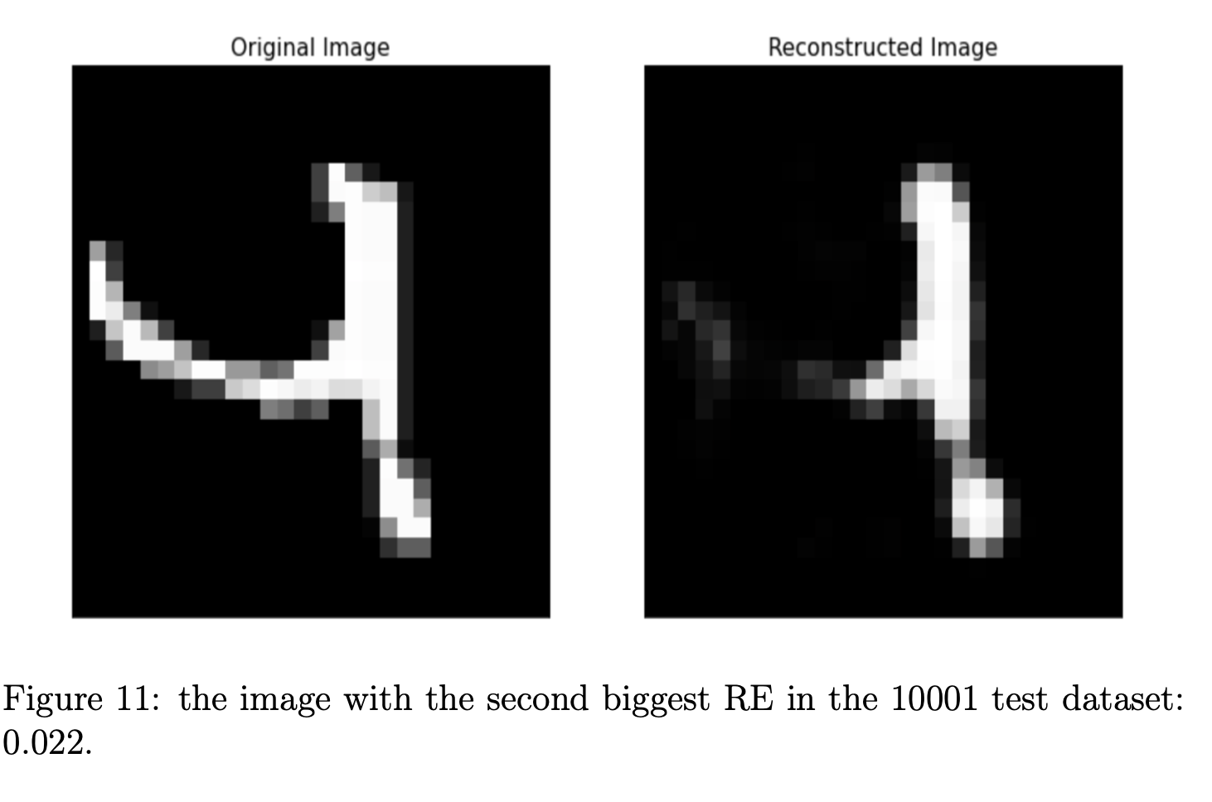
Anomaly detection – second larger RE
Michelucci, Umberto. "An Introduction to Autoencoders." arXiv preprint arXiv:2201.03898 (2022).

Slide 20
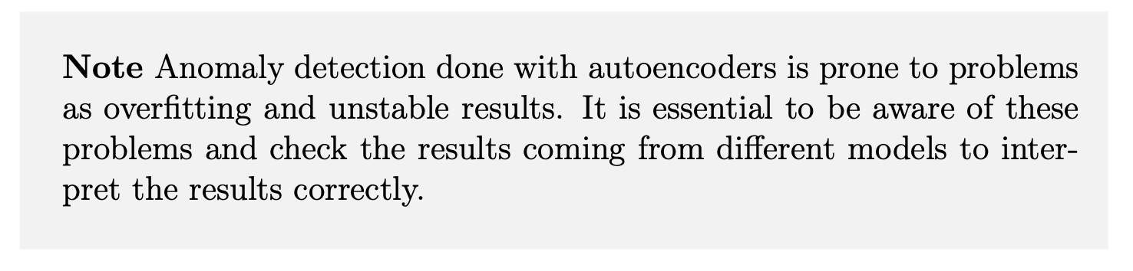
Small warning…
Michelucci, Umberto. "An Introduction to Autoencoders." arXiv preprint arXiv:2201.03898 (2022).

Slide 21
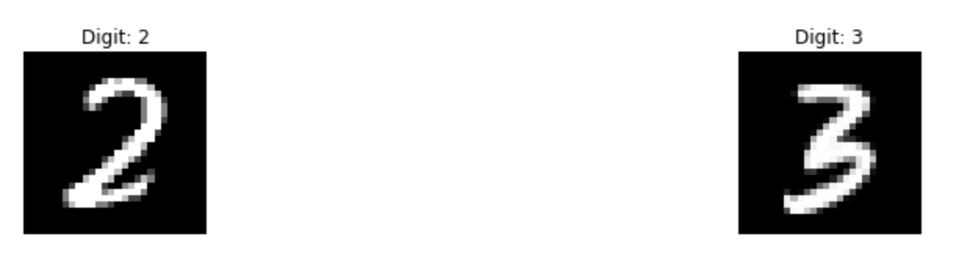
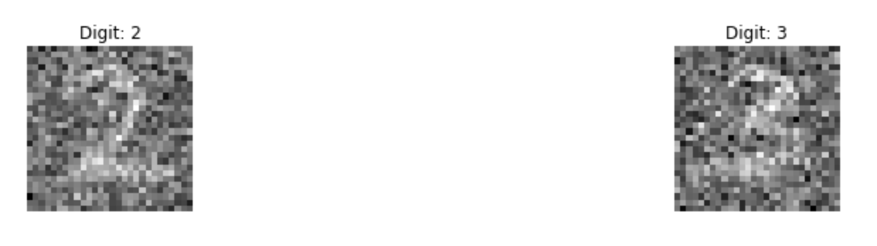
Denoising Autoencoders
noise = np.random.normal(0, 1, pure.shape)

Slide 22
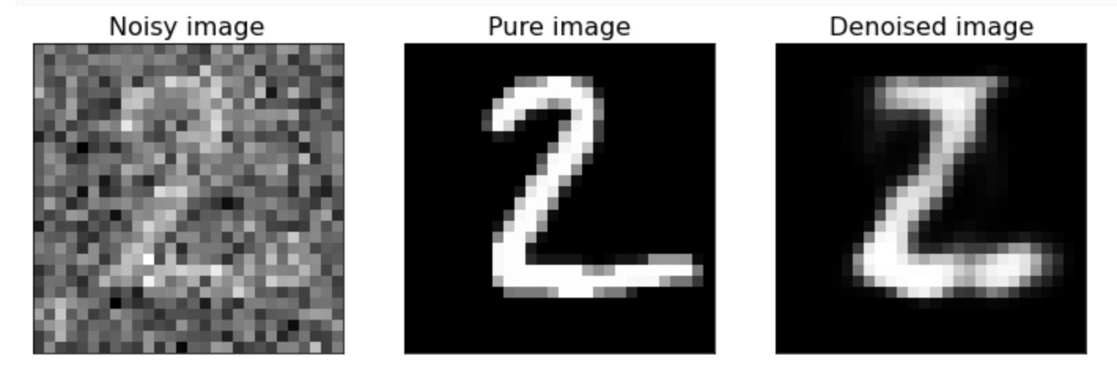
Denoising autoencoders (FFA) (784,32,784)
http://adl.toelt.ai/Autoencoders/Denoising_autoencoders_with_FFNN.html

Slide 23
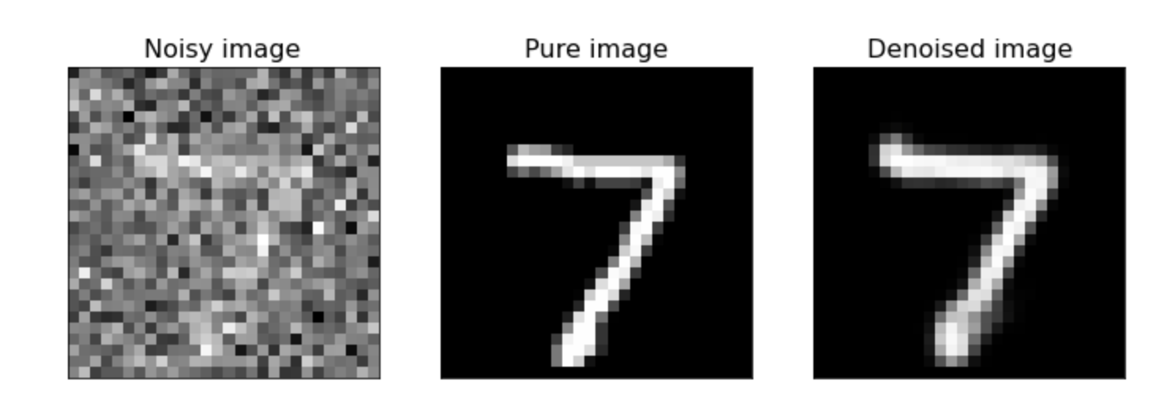
Denoising autoencoders (CNN) (784,32,784)
http://adl.toelt.ai/Autoencoders/Denoising_autoencoders_with_CNN.html

